Slide 1
My Journey into Dependency Injection
Dave Mateer
www.github.com/djhmateer/AltNetDI

Slide 2
Exploring DI!
Notes:
*okay to record sound and my screen?*
Who I am – Dave Mateer, Software developer with .NET for 7 years, work for an Edinburgh based company doing a lot of legacy coding in Financial Services organisations
What this is about – A way of coding or pattern. Inspired by a discussion here at alt.net, and "when is a project big enough to use Dependency Injection". Share my initial despair at increase in complexity.. Then realisation it is not so hard. Pathway to creating testable maintainable code for real applications.
Why should you care - A lot of time maintaining and extending existing code
One of the ways to make maintainable code is through loose coupling. DI enables loose coupling

Slide 3
Demo of Final App
Notes:
Example8
This is a console app which reads a text file (sql in it), searches for an old db name, replaces it with a new dbName
Then writes the output to the screen
Show text file
This application is going to be long lived and needs be maintained over many years and many developers
One of the ways to make maintainable code is through loose coupling

Slide 4
What is DI?
“…providing the objects that an object needs (its dependencies) instead of having it construct them itself ”

Slide 5
DI Examples
“One of the ways to make maintainable code is through loose coupling.
DI enables loose coupling”
Notes:
Step through code with debugger slowly
Run app – showing output
Diagram
Questions?
Collapse code down
**lego piccie

Slide 6
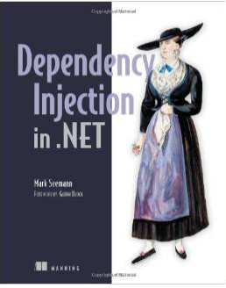
Discussion and Thank You!
Poor Mans DI / Pure DI / Constructor Based DI – a way of doing Dependency inversion
Dependency Inversion / IoC Inversion of Control – the pattern or principle
Github.con/djhmateer/altnetdi
Notes:
IoC Container – Unity, ninject, Castle Windsor
Lifestyle” (Windsor) Lifecycle of component – singleton, transient, perwebrequest
How things get disposed?

